Slide 1
DBE Reporting

Slide 2
DBE Goal
Title 49 Chapter A Part 26 Subpart C Section 26.45
Requires a two-step process for setting the overall DBE goal, which should reflect the expected level of DBE participation in SCDOT contracts in absence of discrimination.
Recommended that SCDOT propose to establish its DBE overall goal for Federal Fiscal Years 2018-2020 at 4% with the entire amount projected to be met through race-neutral measures.

Slide 3
DBE Goal

Slide 4
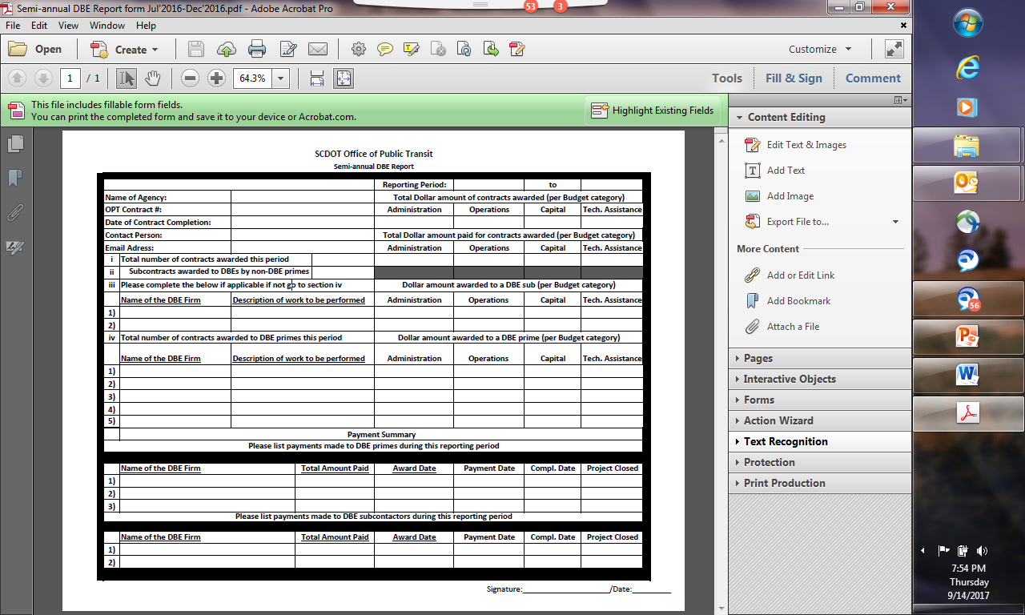
Semi- Annual DBE Report

Slide 5
Semi- Annual DBE Report

Slide 6
Semi-Annual DBE Report
Terminology:
OPT Contract Number
Date of Contract Completion
Contract Opportunity
Contract Award
Total $$ Amount of Contracts awarded
Total $$ Amount of Contracts paid.

Slide 7
Semi- Annual DBE Report

Slide 8
Semi- Annual DBE Report

Slide 9
Semi-Annual DBE Report
Reminders:
Reporting Periods and Due Dates
  July 1, - December 31 – April 15
  January 1, - June 30 – October 15
Report only contract opportunities
Report only the Federal Dollar contribution
  Administrative
  Operations
  Capital
  Technical Assistance

Slide 10

Semi-Annual DBE Report

